Slide 1
Diagrams

Slide 2
Low level diagram

Slide 3
Sequence diagram

Slide 4
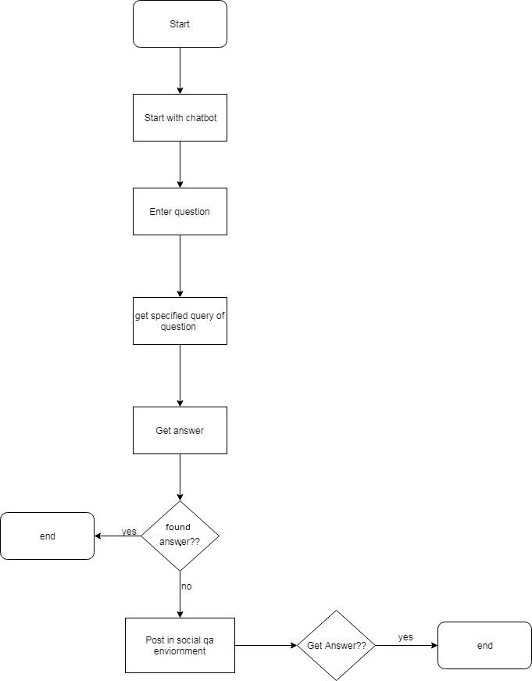
Flowchart

Slide 5
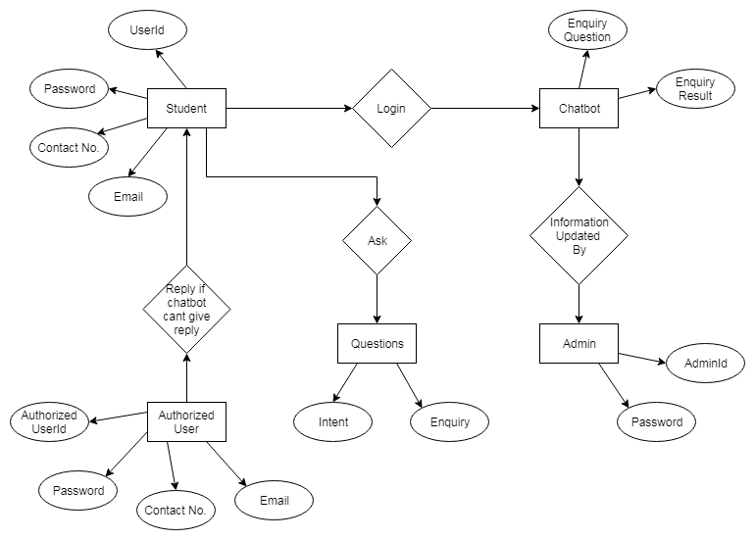
ER diagram

Slide 6
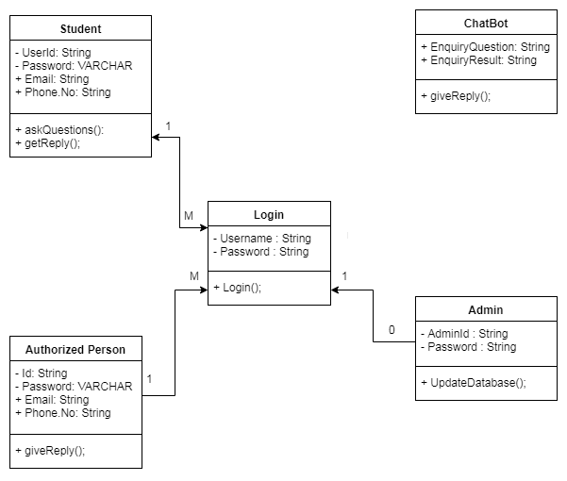
Class diagram

Slide 7
High level diagram

Slide 8
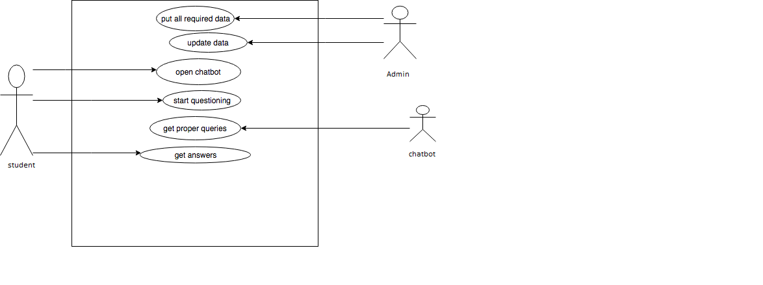
Use case diagram

Slide 9
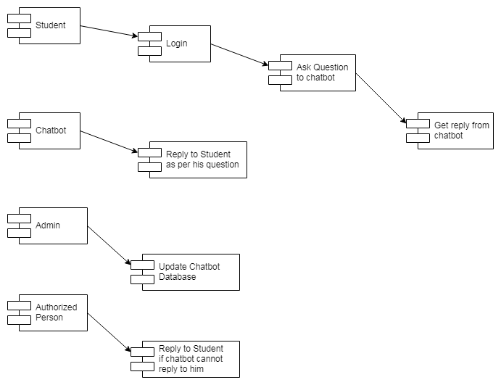
Component diagram

Slide 10
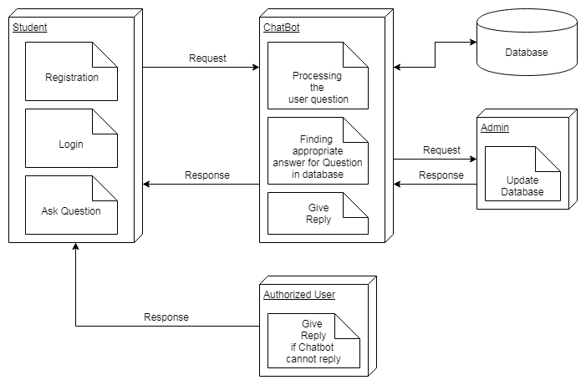
Deployment diagram

